Slide 1
Introducing WildPosh
Pan-European assessment, monitoring, and mitigation of chemical stressors on the health of wild pollinators

Slide 2
Context

Slide 3

Background
Aim
Wild fauna and flora are facing variable and challenging environmental disturbances. One of the animal groups that is most impacted by these disturbances are pollinators. Pollinators face multiple threats, but the spread of anthropogenic chemicals (i.e. pesticides) form a major potential driver of these threats.
WildPosh is a multi-actor, transdisciplinary project whose overarching mission is to significantly improve the evaluation of the risk to wild pollinators of pesticide exposure and enhance the sustainable health of pollinators and pollination services in Europe.
Duration
Plan
48 months: January 2024 – December 2027
41 Deliverables & 14 Milestones

Slide 4
Consortium

Slide 5














14 partners across 9 countries
3 associated
Coordinator

Slide 6
Objectives and actions

Slide 7


OBJECTIVE
7
ACTION
Determine the
real-world agrochemical exposure profile of wild pollinators at landscape level, within and among sites
Provide the first pan-European
quantification of the exposure hazard of pesticides to representative wild pollinators while characterising their populations
Provide the first pan-European
quantification of the exposure hazard of pesticides to representative wild pollinators while characterising their populations

Slide 8


OBJECTIVE
ACTION
Characterise causal relationships between pesticides and pollinator health
Use integrated and controlled laboratory and semi-field experiments, determining how major categories of pesticide alone and in mixtures affect pollinator health

Slide 9


OBJECTIVE
ACTION
Build open database on pollinator traits/distribution and chemicals to define exposure and toxicity scenario
Develop databases on ecological traits and the spatial distribution of pollinators in relation to their potential exposure to pesticide, and on pesticide use and their toxicity

Slide 10



Objective
OBJECTIVE
ACTION
Propose new tools for risk assessment on wild pollinators
Propose integrated systems-based risk assessment tools for wild pollinators

Slide 11


OBJECTIVE
ACTION
Drive policy and practice
Use innovation to meet the need for monitoring tools, novel screening protocols, and practice- and policy-relevant research outputs to local, national, European, and global stakeholders

Slide 12
Work Packages

Slide 13
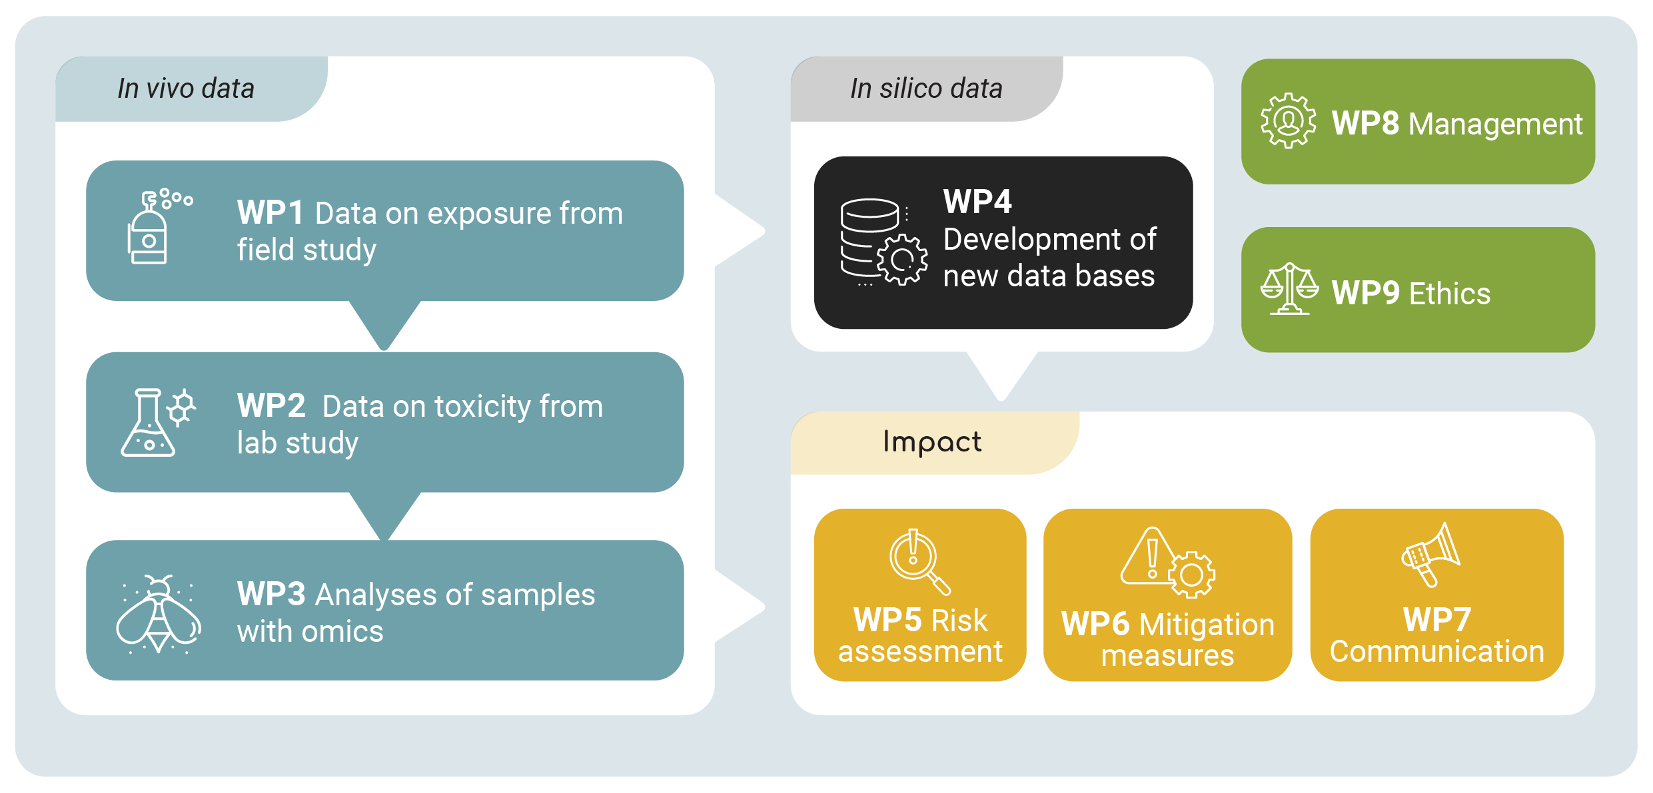
Notes:
Key points:
Multi-actors
Usable results on the ground
Trandisciplinary
Stakeholder engagment
-> Highly interlinked WPs

Slide 14







WP1
A monitoring scheme to determine sources and routes of pesticide exposure in environmental compartments/ matrices
Determine optimal sampling methods and proxies for pesticide contamination in environmental compartments/matrices
Quantify pesticide contamination across matrices/compartments collected across the monitoring scheme
Establish a site network to quantify sources and exposure routes of pesticides in
agri-ecosystems
Devise and test a monitoring scheme for establishing the level of contamination of pollen/nectar/water/plant matrices/soil that can support future benchmarking

Slide 15


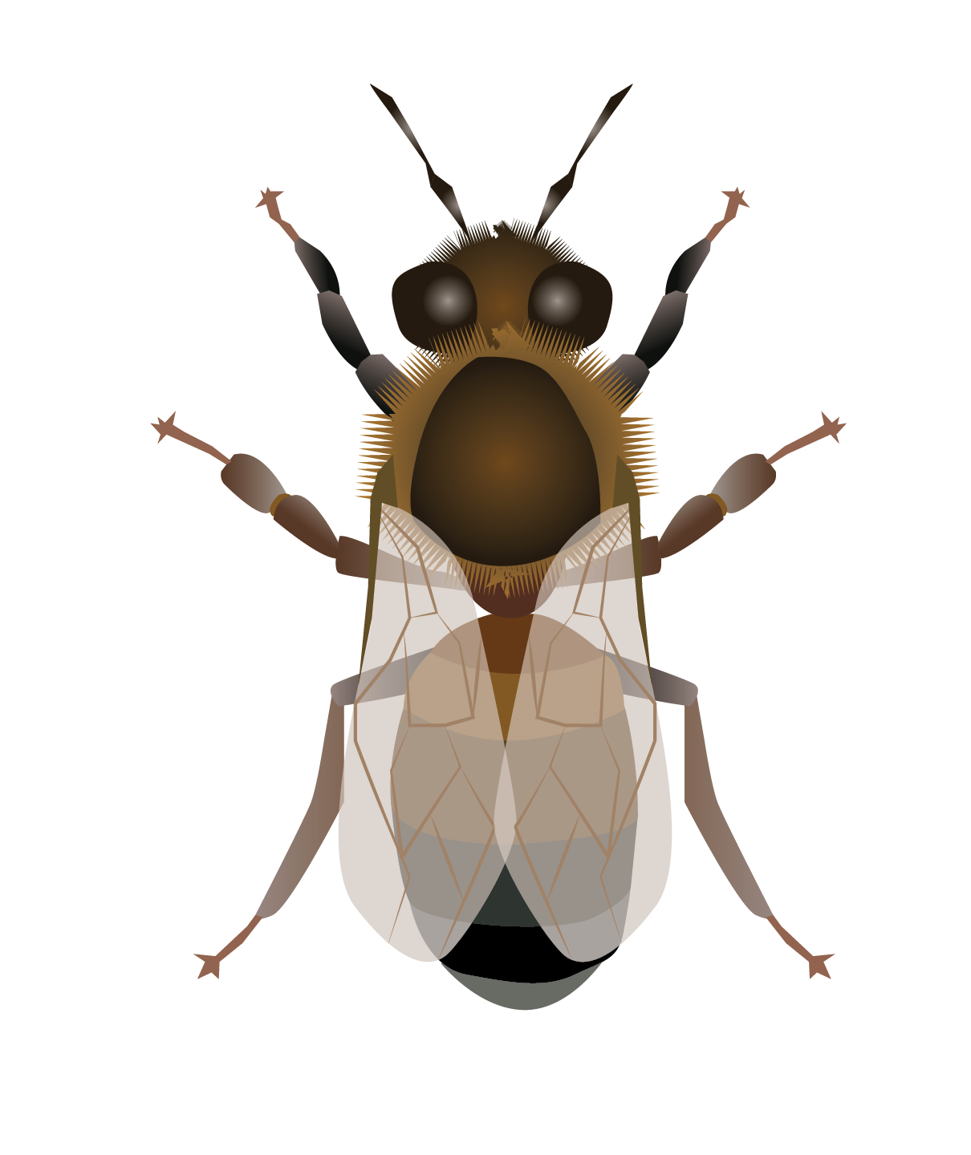

WP2
Effects of exposure to single pesticides single exposure and their mixtures on wild pollinators as novel models in laboratory and semi-field experiments
Evaluate the variability among wild insect pollinators of Europe in their sensitivity to pesticides
Define the extent to which semi-field sensitivity mirrors lab sensitivity to pesticide in wild pollinators
Develop OECD protocols for testing wild insect pollinators in pesticide risk assessment

Slide 16



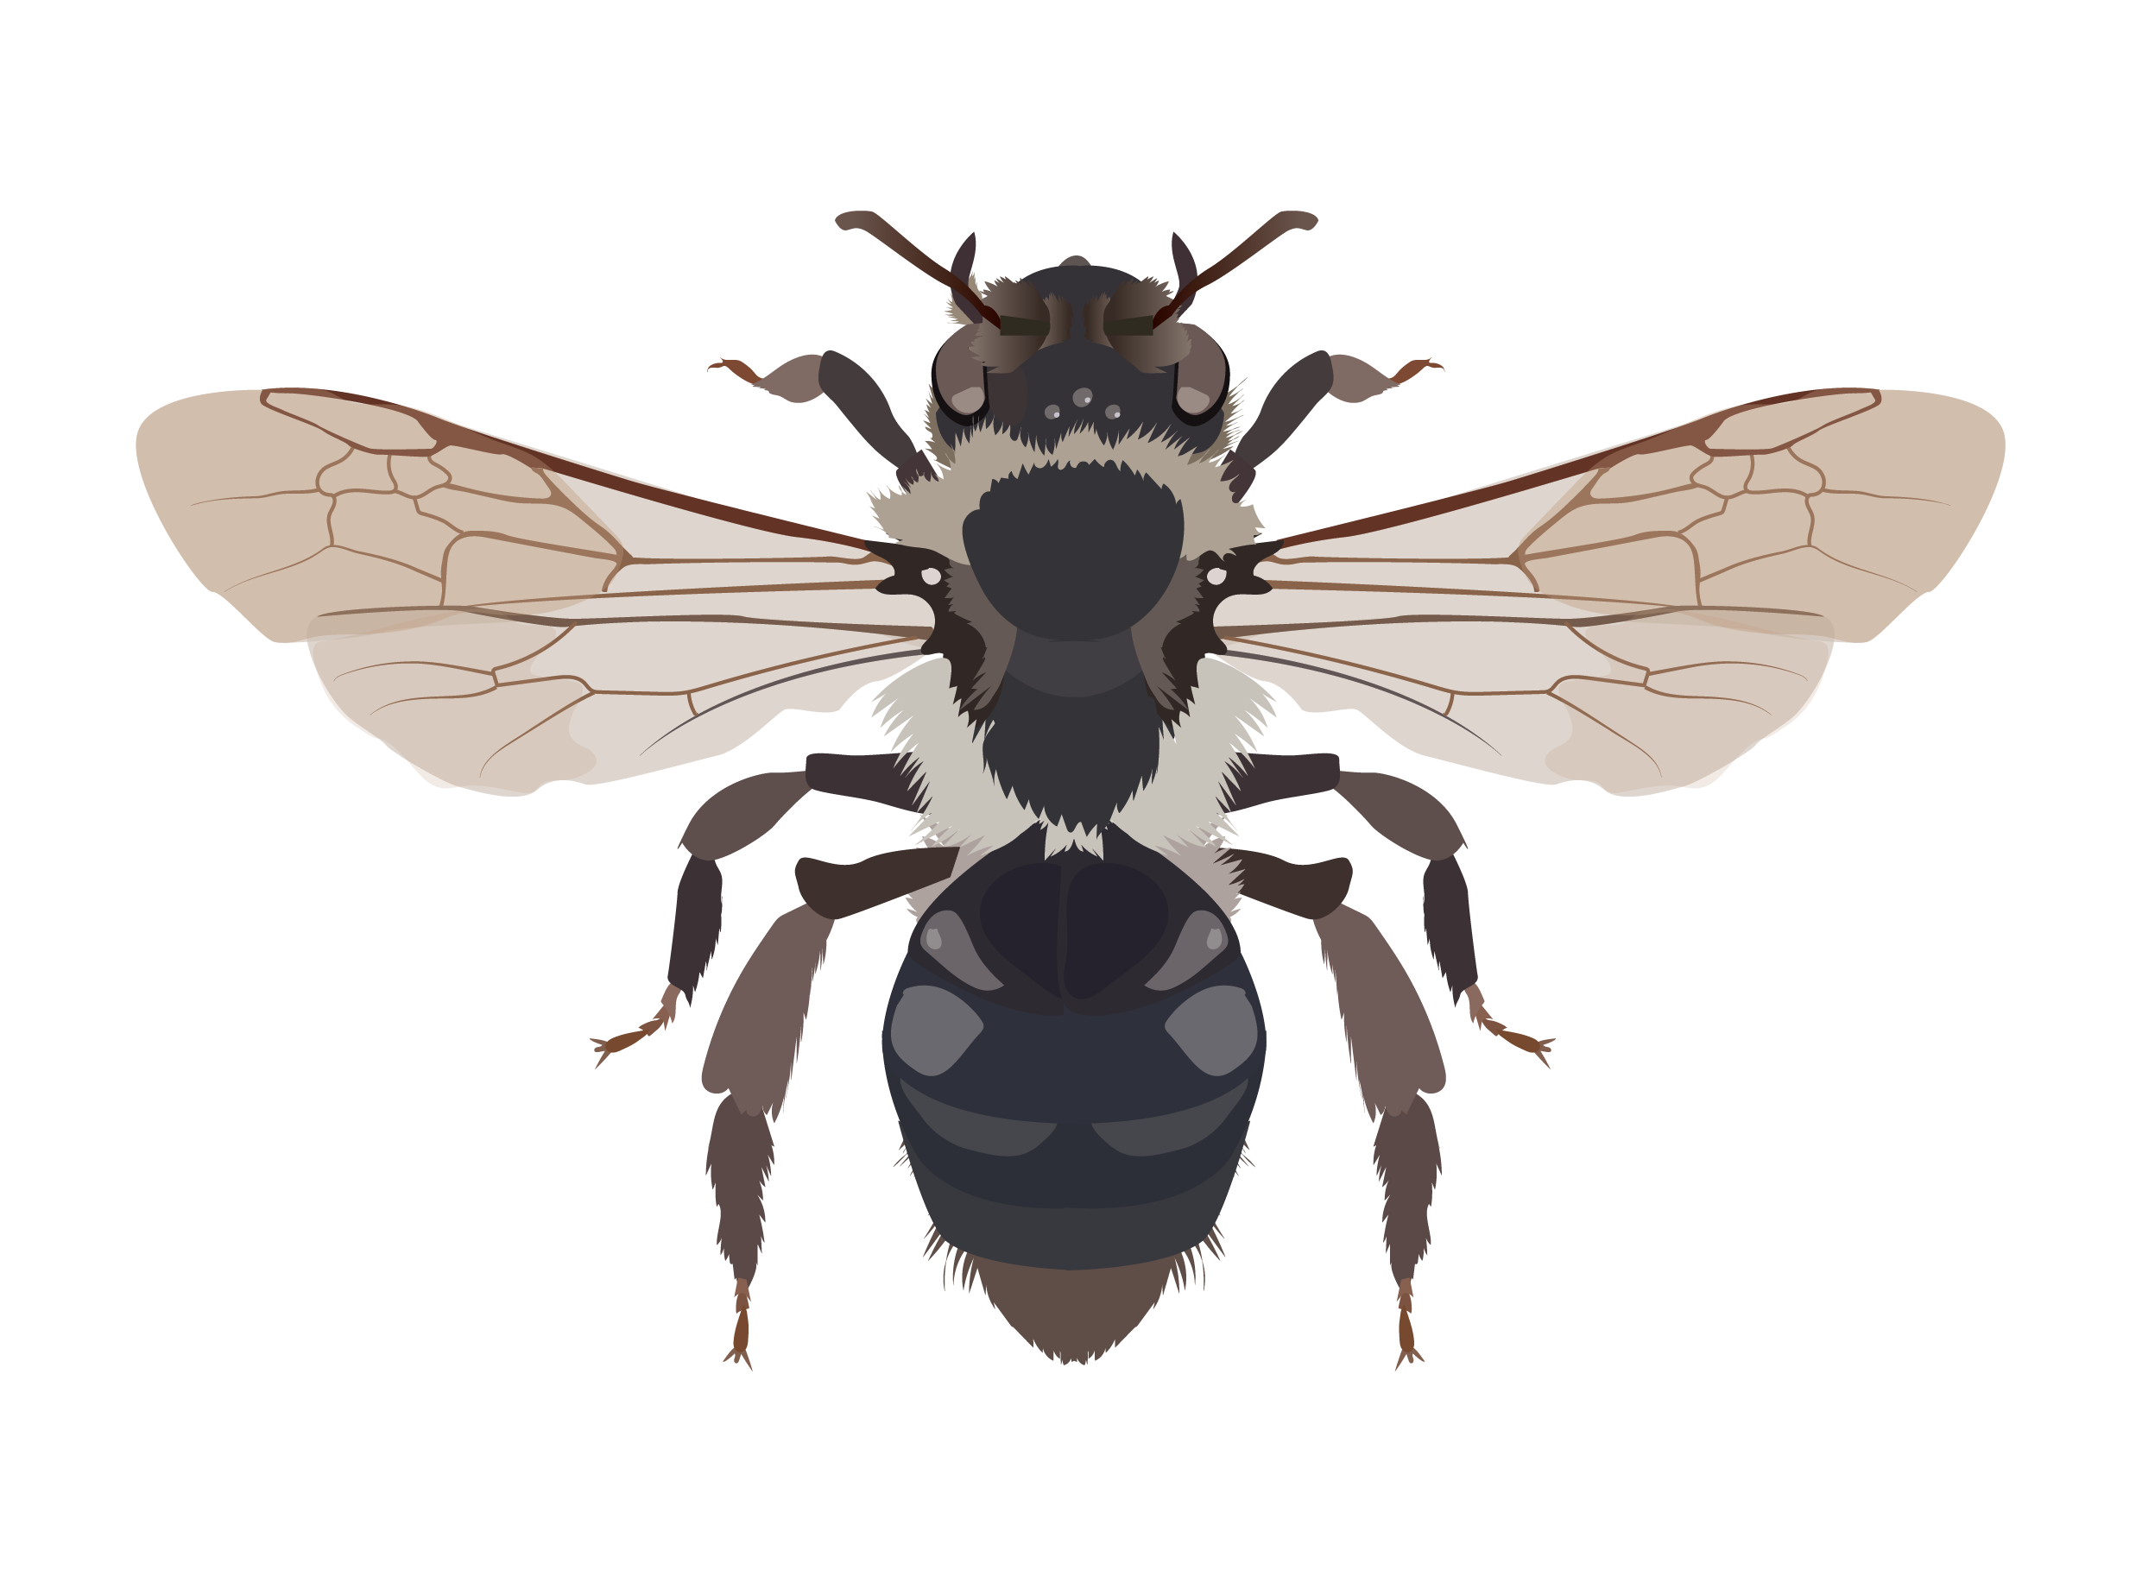

WP3
Omics of pesticide responses in pollinators
To elaborate MALDI-MS molecular fingerprints (MFPs) of fat bodies and haemolymph to understand the consequences of pesticides exposures on juvenile and adult wild pollinators
To assess the overall stress response to pesticides on the peptidome/proteome dysregulation by off-gel bottom-up proteomics and molecular mass imaging
Define diagnostic transcriptional signatures that can be used to predict sensitivity to pesticide exposure of pollinators in the field
To decode the molecular machinery underlying the response of pollinators to pesticides

Slide 17




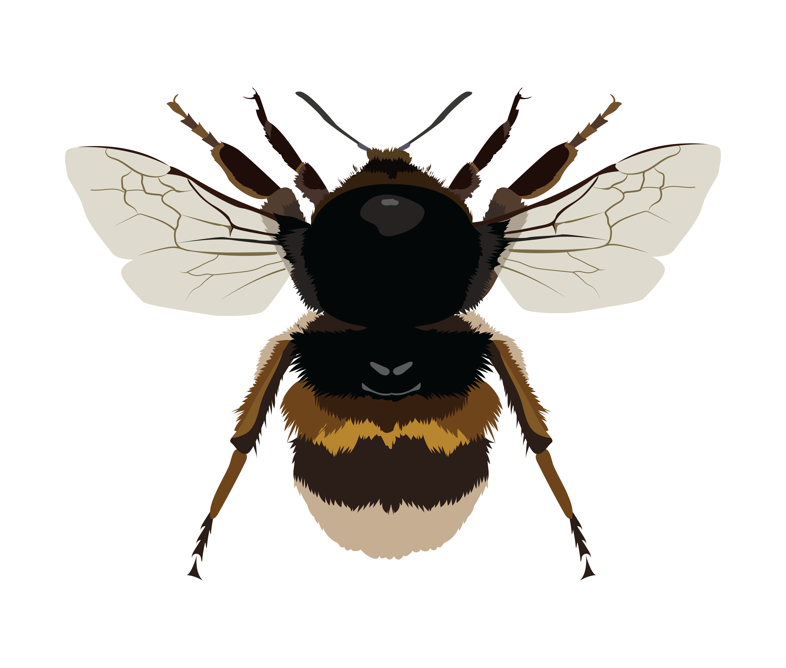


WP4
Data curation and in silico modelling for risk assessment
Compile a comprehensive trait database which will include traits reflecting sensitivity and exposure risk of European pollinators to pesticides and other stressors
Compile distributional and occurrence information on European pollinators at national and continental levels
To identify and collate data on pesticide exposure and effects, as well as on other stressors able to amplify the adverse effects on model species
To improve the existing in silico prediction methodologies for toxicity endpoints relevant to pollinators (e.g., QSAR models)
To build an open-source curated database which will include information on pollinator traits and distribution, on pesticides, and on other stressors for model species

Slide 18




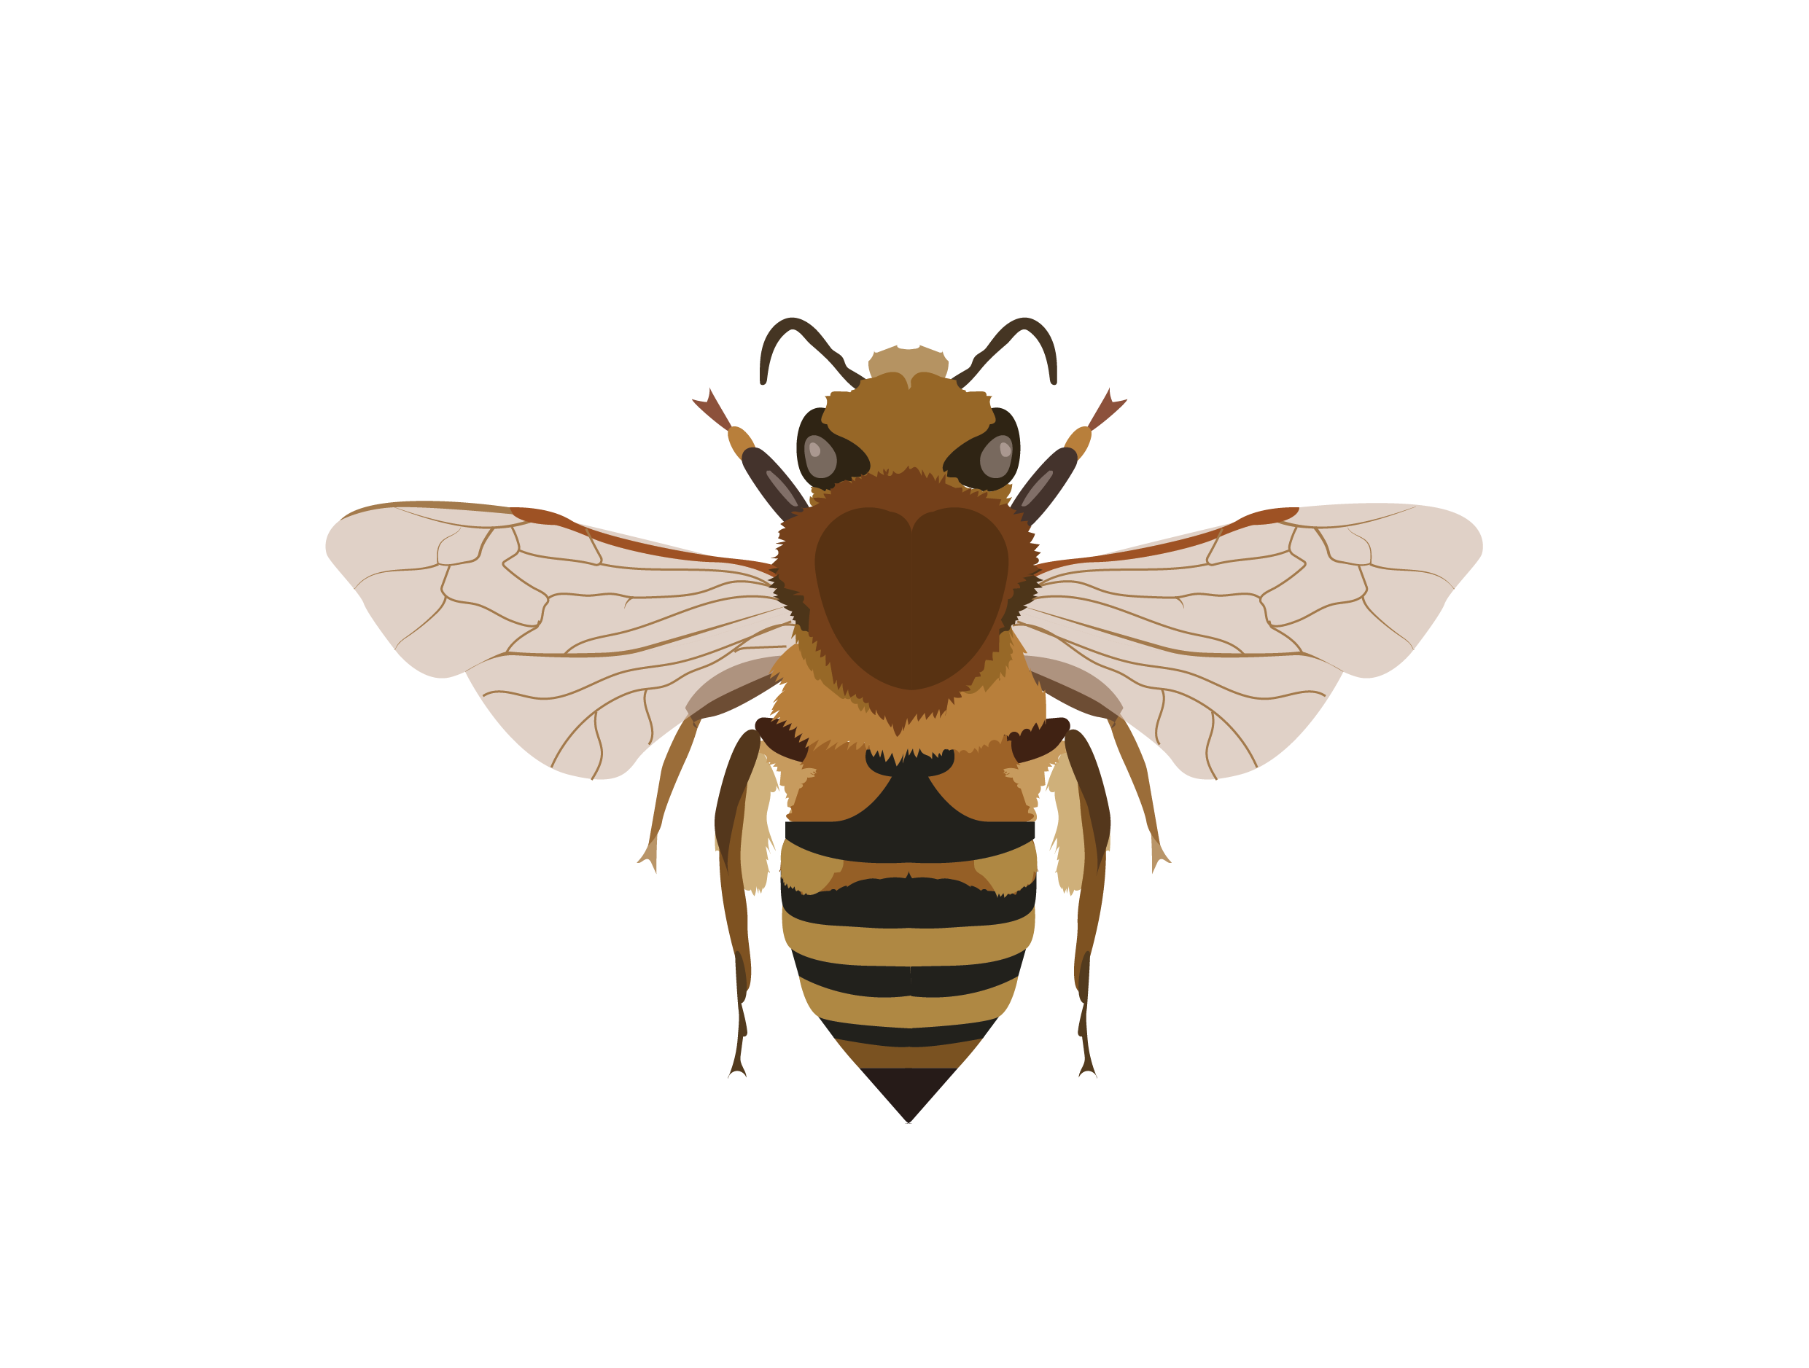

WP5
Integrated systems-based risk assessment
Critically review current approaches of risk assessment and provide strategies for improvement integrating lethal and sublethal effects of single and multiple pesticides including interactions
Develop landscape models integrating pesticide exposure and hazard to inform predictive pollinator population and community risk models
Develop environmental scenarios for pesticide risk and mitigation models
Develop an integrated open-access tool for a systems-based risk assessment

Slide 19



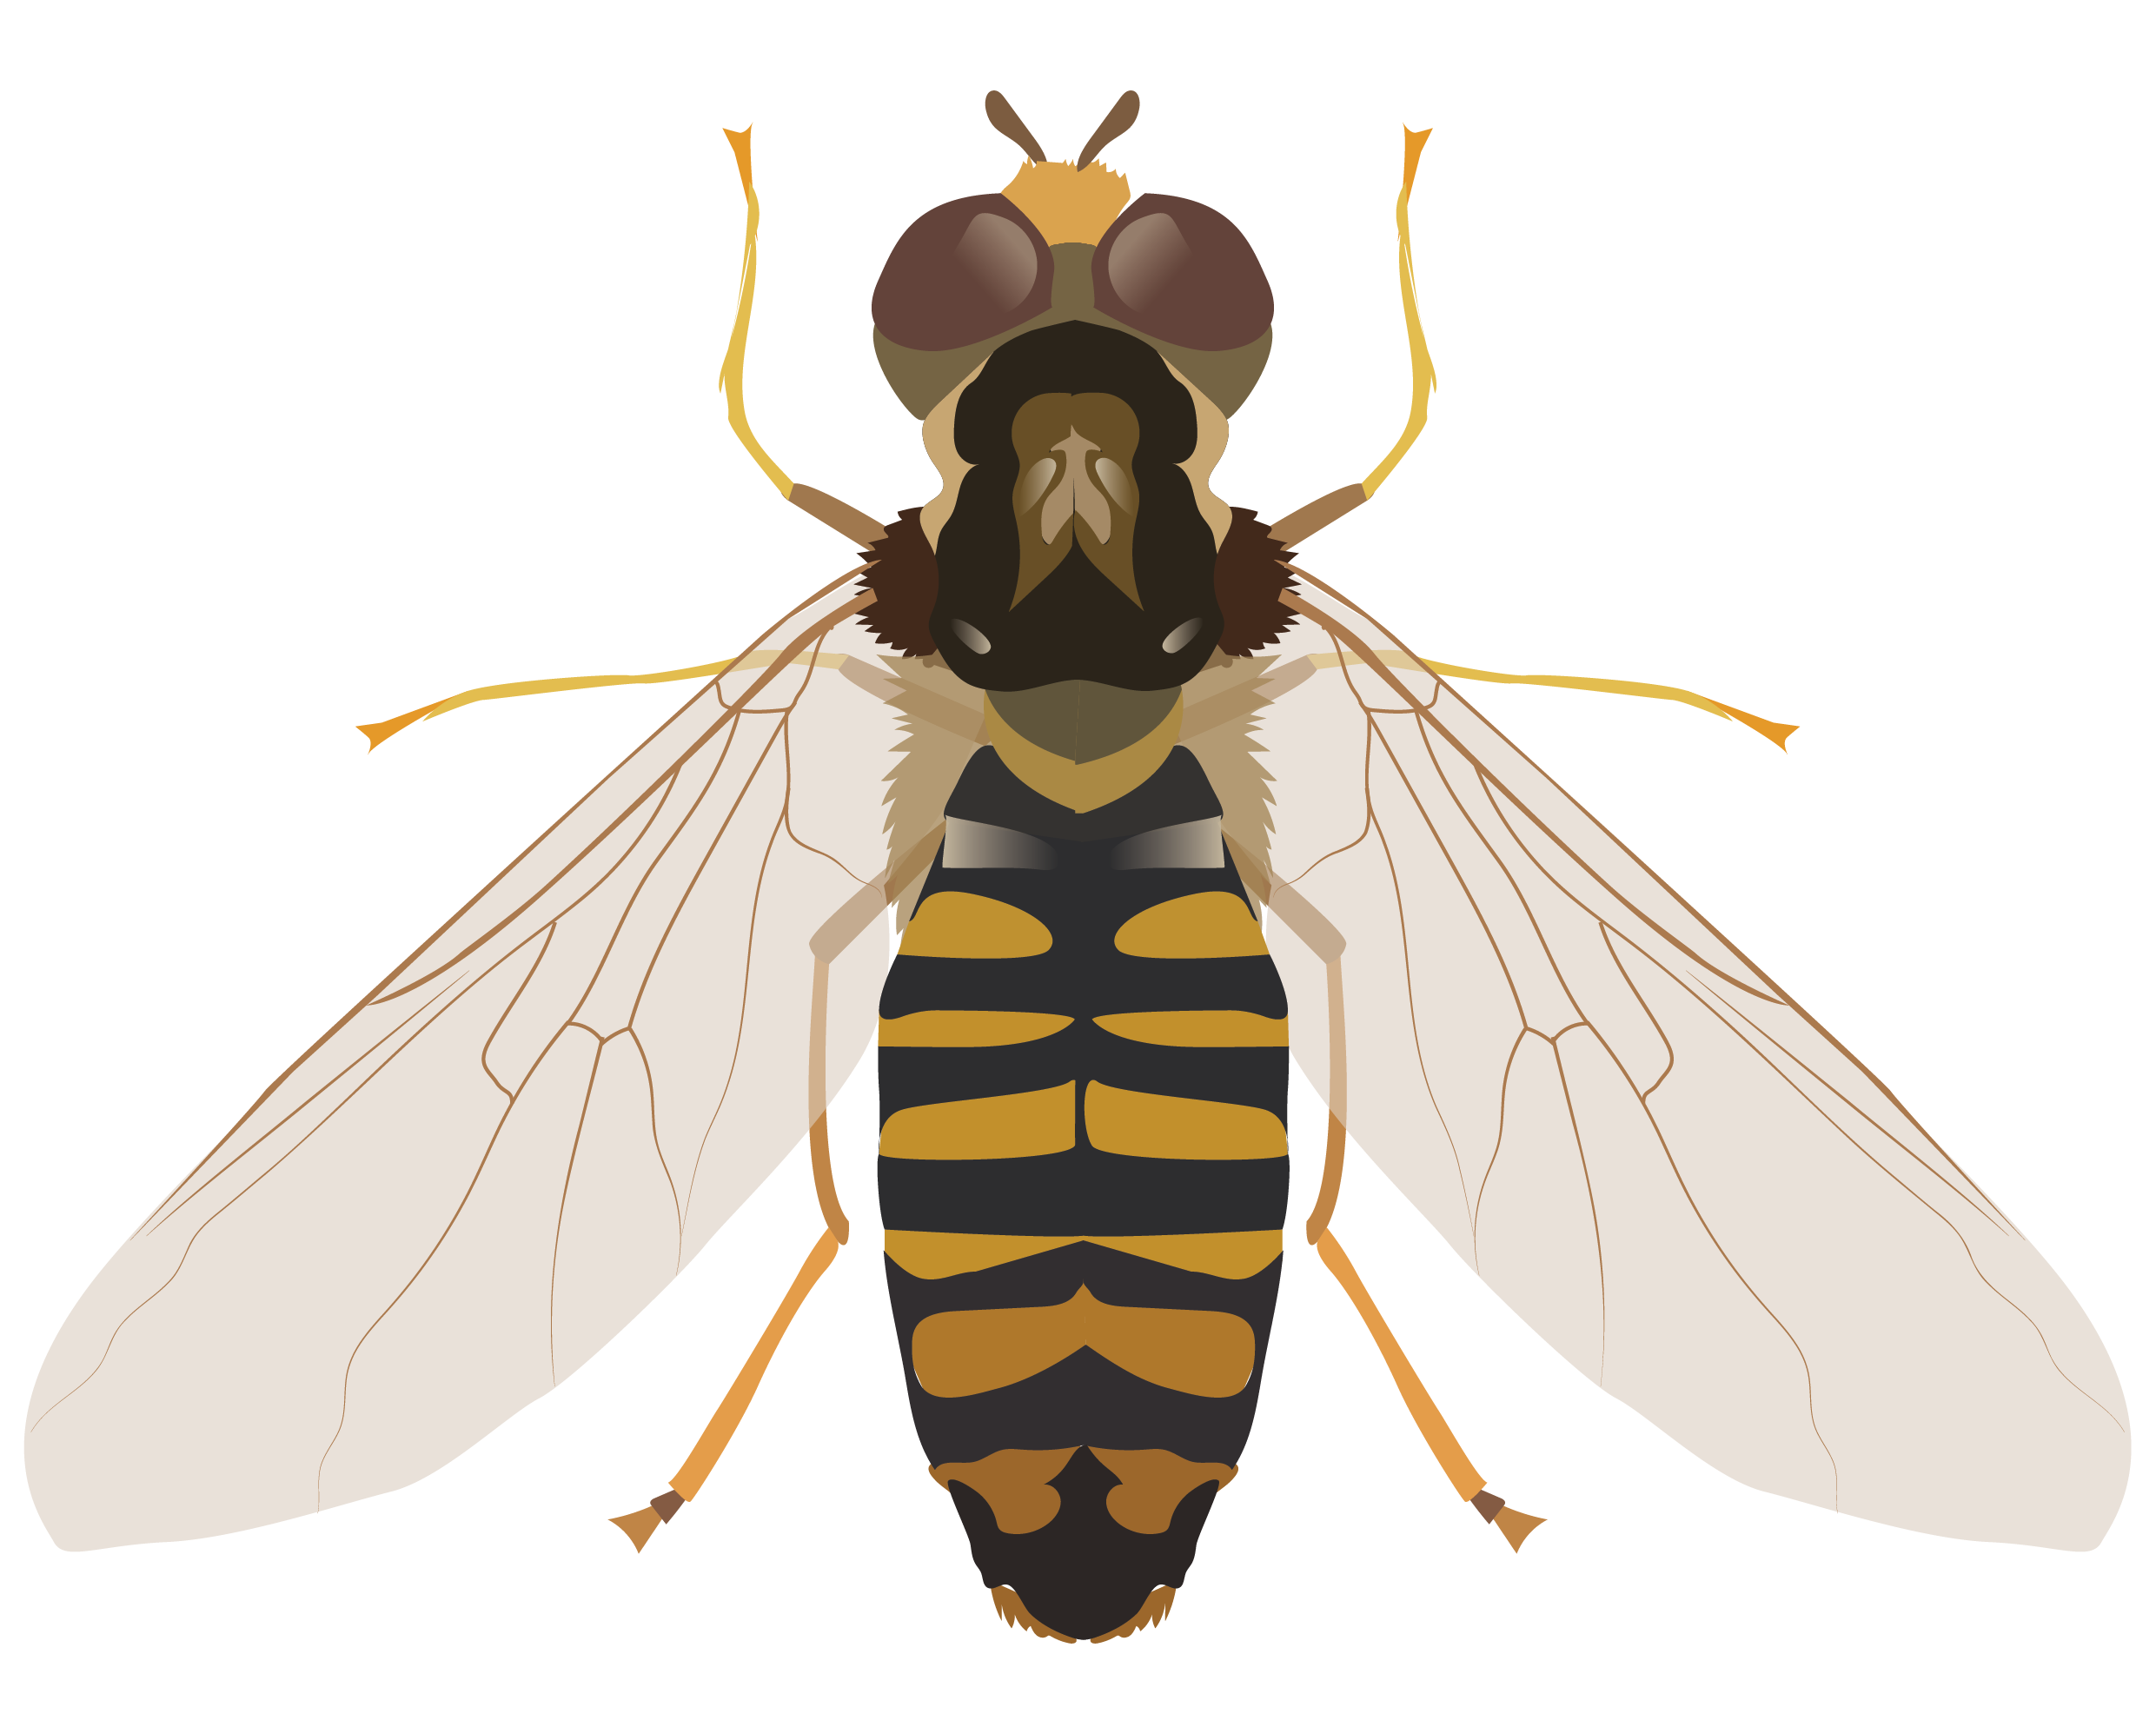

WP6
Integrated systems-based risk assessment
Identify effective response options to reduce pesticide risks to wild pollinators
Synthesise WildPosh project findings and external knowledge
Develop good practice guides for practitioners to mitigate the impacts of pesticides on wild pollinators
Engage in science-policy dialogues to inform national and international policy on the development of mitigation measures

Slide 20



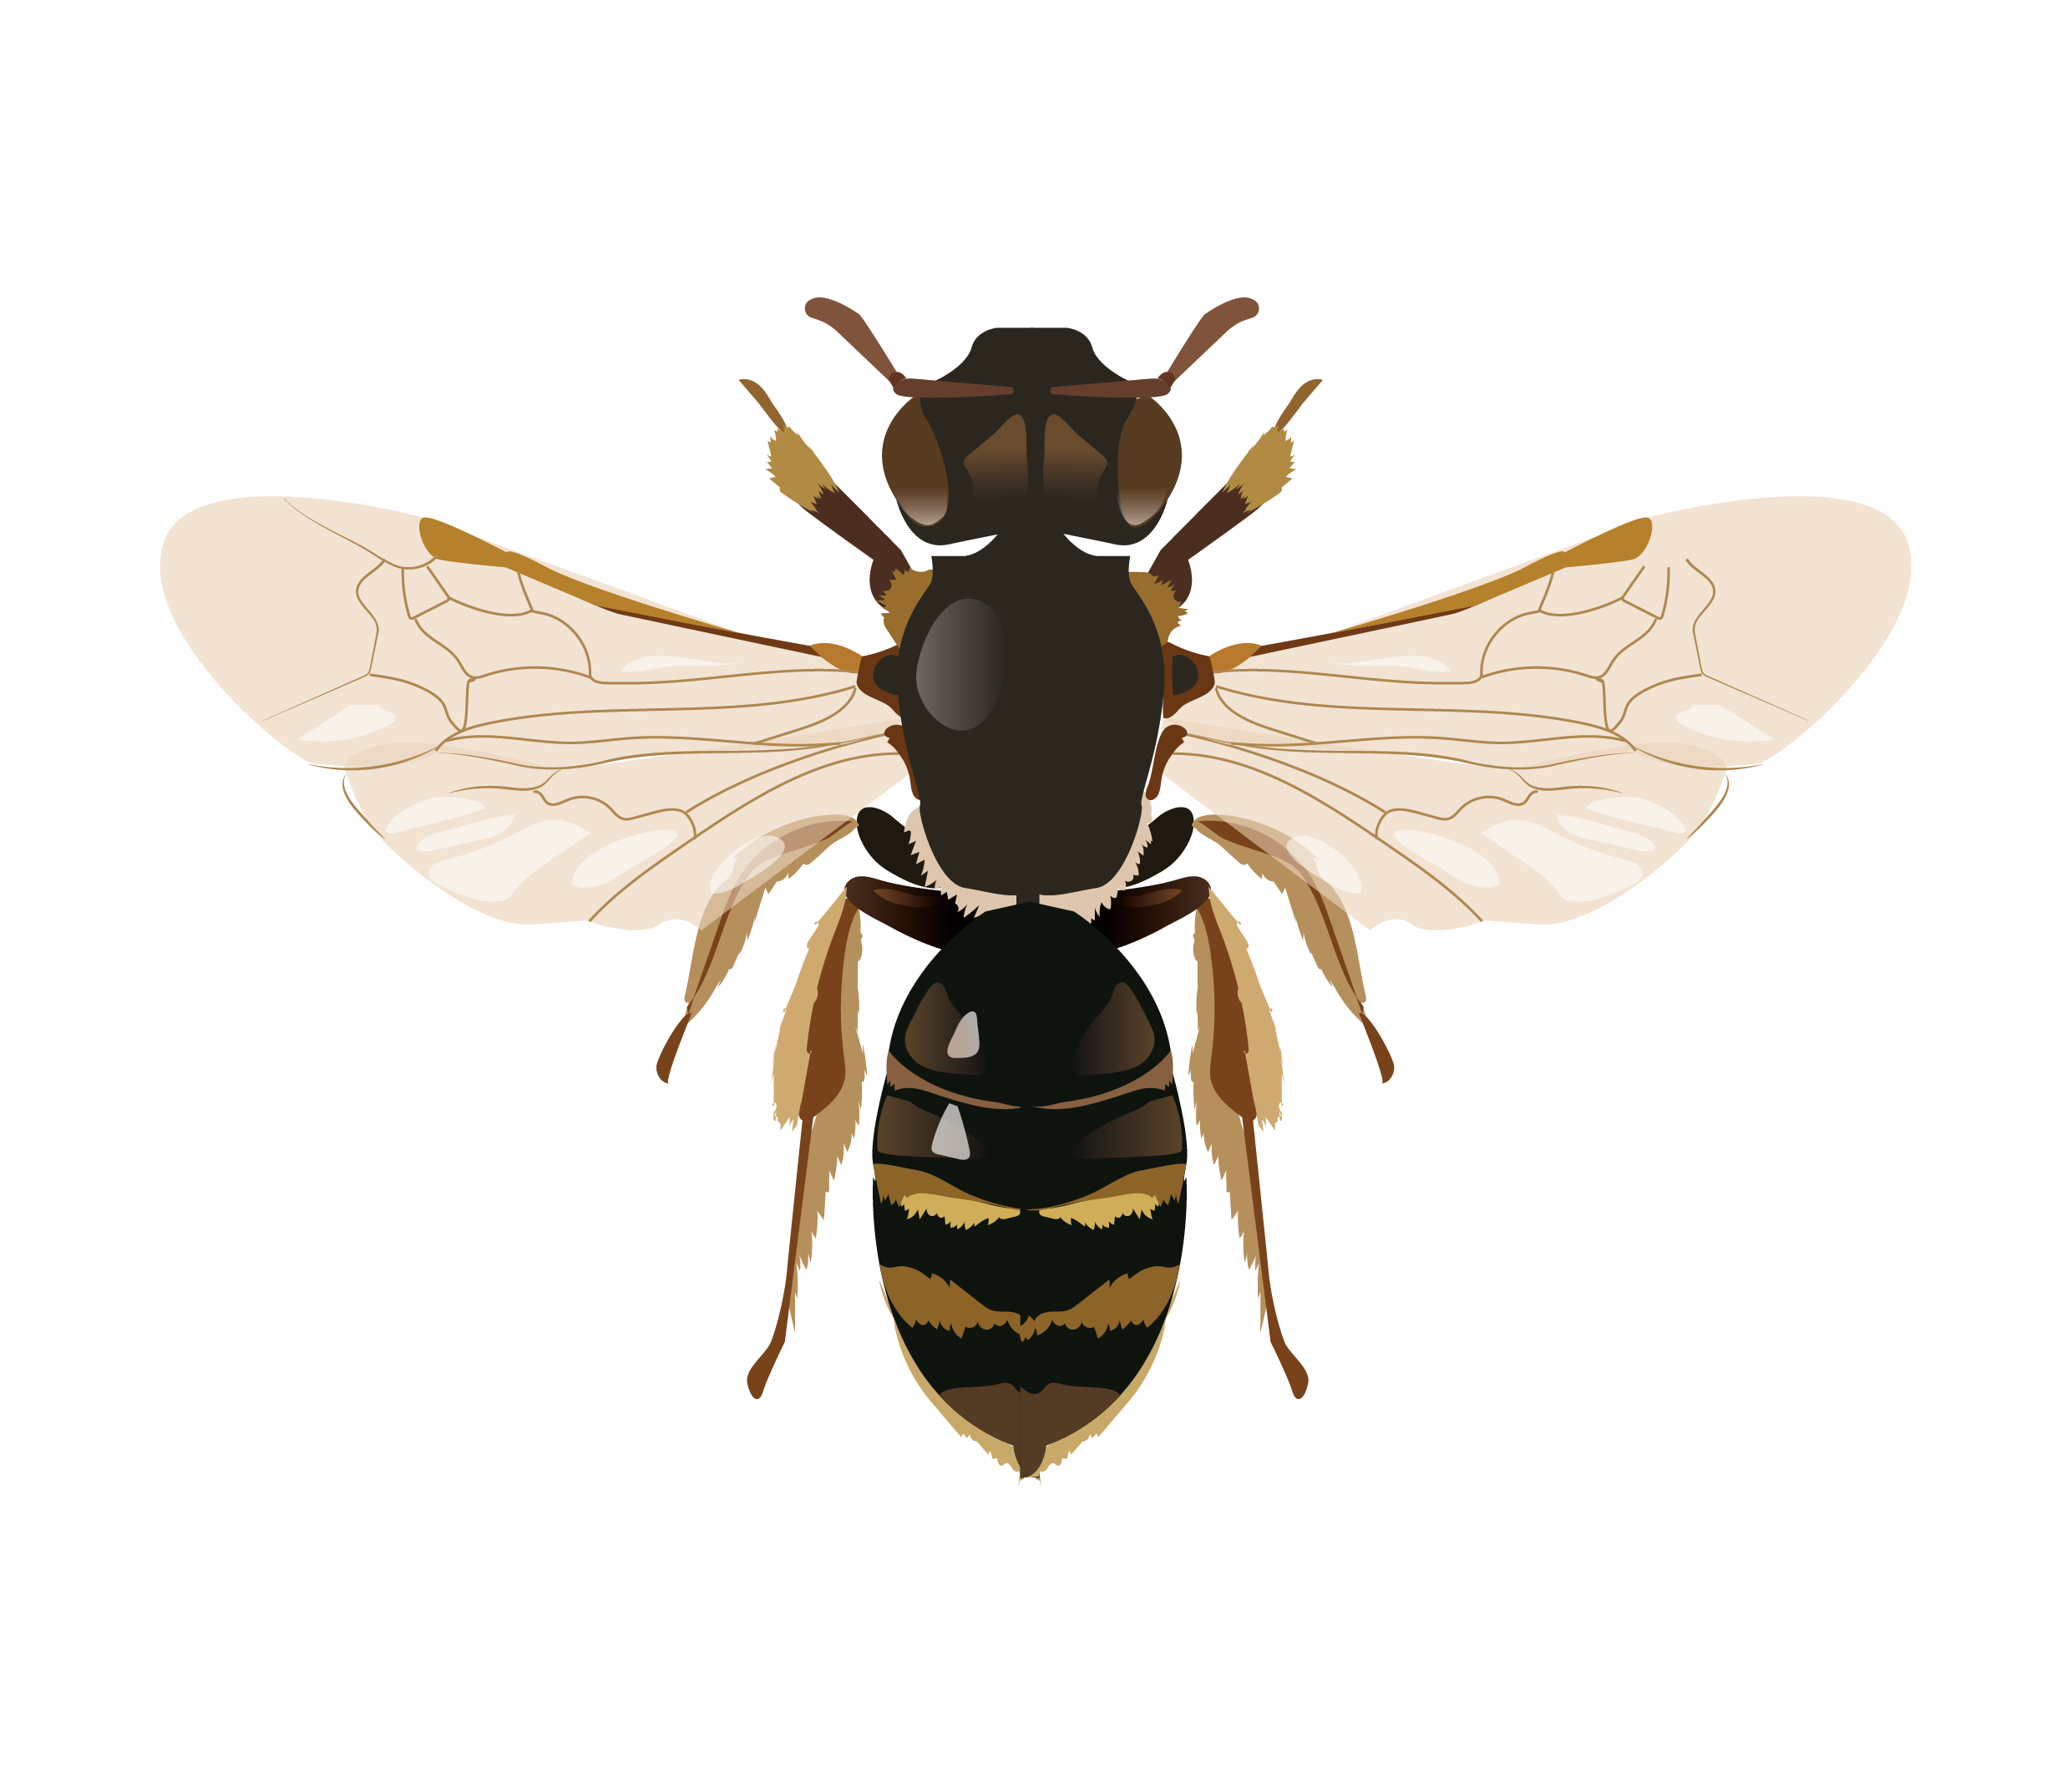

WP7
Communication, knowledge exchange and impact
Raise awareness of the project through a recognisable project branding and website
Develop a Communication Plan (CP) and Plan for the Exploitation and Dissemination of Results (PEDR) to ensure the impact and long-term legacy of the project’s results
Maximise WildPosh’s outreach to relevant stakeholders of the quadruple helix model
Establish collaboration paths and synergies with land to sea ecosystems and biodiversity actors

Slide 21



WP9
Ethics requirements
WP8
Project
Management and Scientific Coordination
Organise internal management structures, ensure scientific reporting and quality control of deliverables, coordinate financial management and reporting to the European Commission, and manage all contractual documents within the consortium and with the European Commission.
Ensure compliance with the 'ethics requirements' set out in this work package
Notes:
WP9 – Ethics requirements
WP8 – Project Management and Scientific Coordination

Slide 22

Sister project
PollinERA and WildPosh share the ambition of providing a better understanding of the exposure routes and toxicological and ecological impacts of chemical pollution on terrestrial biodiversity and ecosystems.
The two projects will unfold in close collaboration to maximise impact and ensure the sustainability of results. Some collaboration mechanisms include joint communication activities and events, a joint data management strategy and activity alignment to solidify the quality of final outputs.

Slide 23
Thank you!
wildposh.eu
@WildPoshProject
@wildposh-eu
wildposhproject

